Slide 1
Installation Guide
(Project Management – Maven 2.2.0)
2009. 07. 21
CODELABOR
Shin Sang Jae (codelabor@gmail.com)

Slide 2
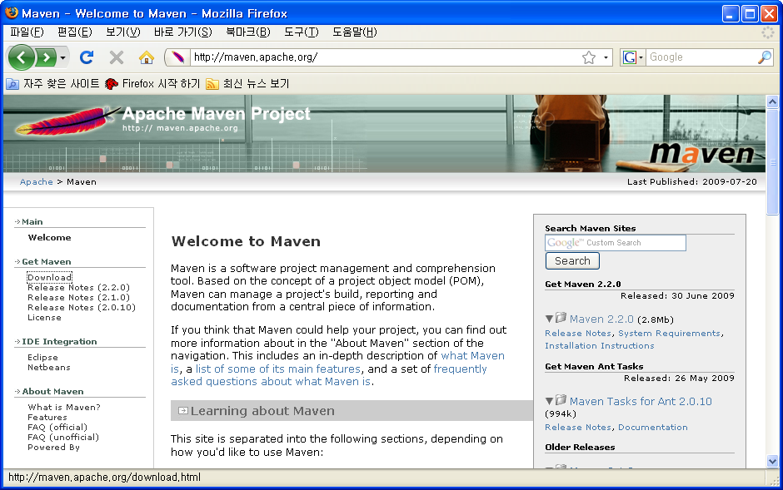
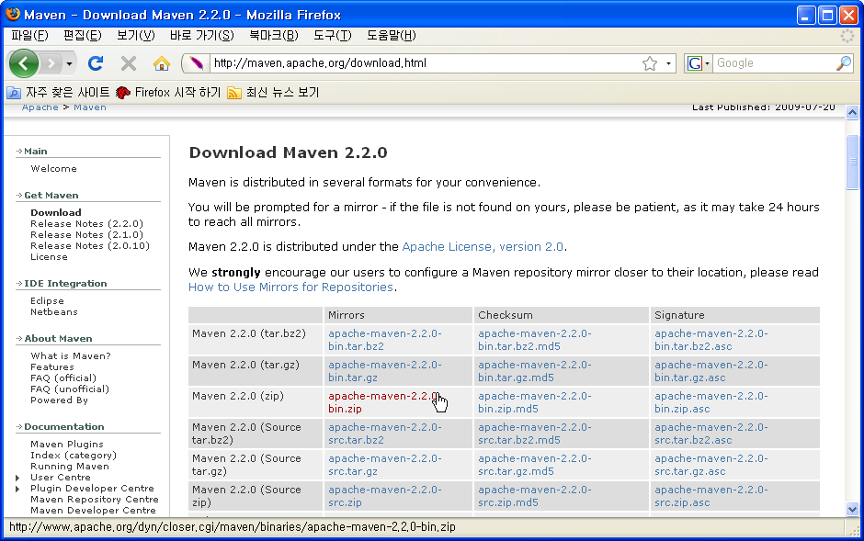
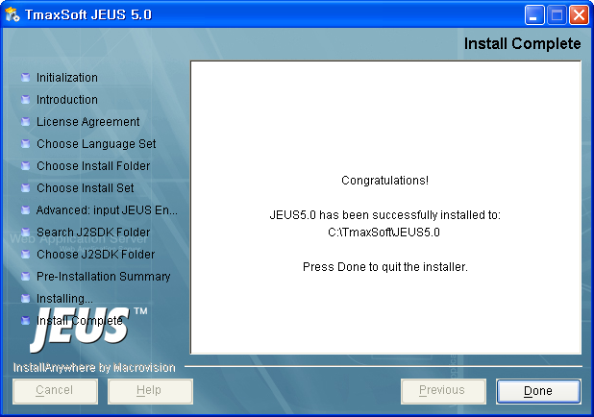
Maven
Install
Official Site: http://maven.apache.org/
Download Site URL: http://maven.apache.org/download.html

Slide 3

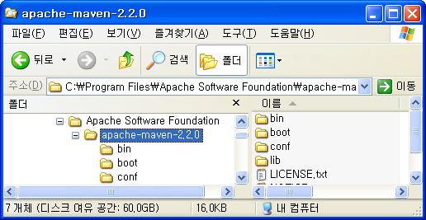

Maven
Install
File: apache-maven-2.2.0-bin.zip
Unzip
Install Directory: C:\Program Files\Apache Software Foundation

Slide 4
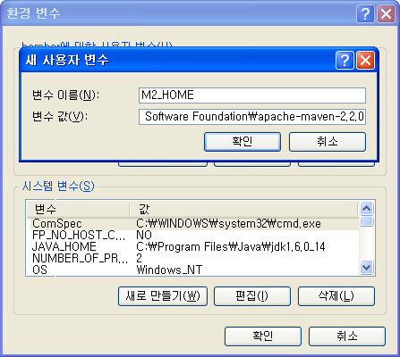
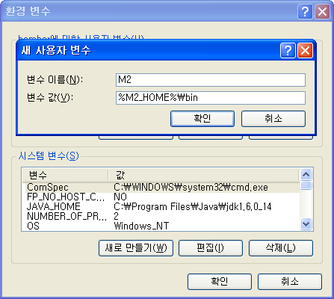
Maven
Environment Variable
Create Environment Variable
  M2_HOME: C:\Program Files\Apache Software Foundation\apache-maven-2.2.0
  M2: %M2_HOME%\bin

Slide 5
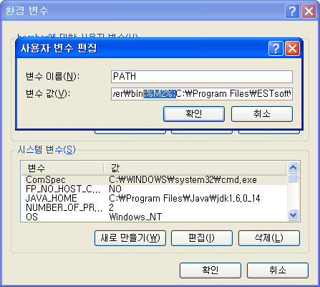
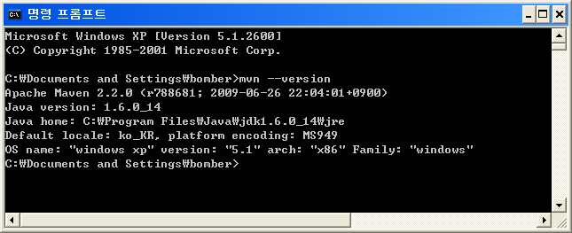
Maven
Environment Variable
Update / Create Environment Variable
  PATH: ...;%M2;...
Check Version
  Command: mvn --version

